Slide 1

Zylentrix Data Analyst
Intern Assignment

Slide 2
Objective
This report presents a comprehensive analysis of student engagement, course performance, and demographics on the Zylentrix online learning platform. The findings are based on a detailed review of enrollment data, student activity, and feedback metrics. Insights derived from this analysis will guide the development of actionable strategies to enhance engagement, increase course completion rates, and improve overall platform performance.

Slide 3
Insights
Top 5 Insights:
1.The overall average completion rate is 54.78%, indicating room for improvement in course completion.
2. Course with Highest Average Engagement Time: DM101 (102.43 mins) and Lowest Average Engagement Time: PY202 (93.90 mins)
3. The average feedback ratings across courses are relatively low, with PY202 scoring the highest at 3.28, and others like WD404 scoring as low as 2.79 on a 5-point scale.
4. Locations such as Kolkata and Delhi show higher average engagement time.
5. Engagement by Age Group
15-25 | 100.76 mins
26-35 | 95.36 mins
36-50 | No data available

Slide 4
Recommendations
Top Recommendations:
1.Create customized engagement plans for underperforming age groups (e.g., 23–34) and cities like Mumbai and Chennai with lower average engagement.
2. Explore qualitative feedback from top engaged users with low ratings to refine course content.
3. Leverage feedback analytics to enhance lower-rated courses using keyword-based sentiment analysis.
4. Introduce badges, leaderboards, or progress-based rewards to encourage users to complete courses and maintain motivation.

Slide 5
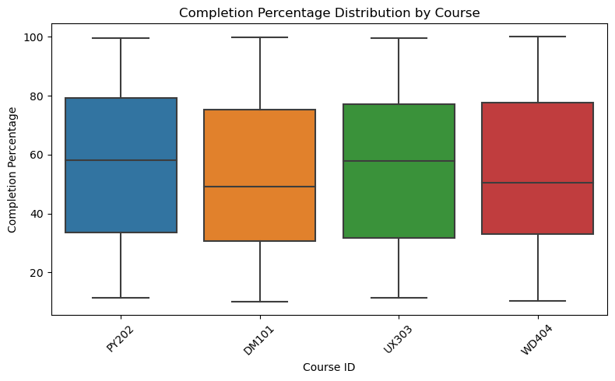
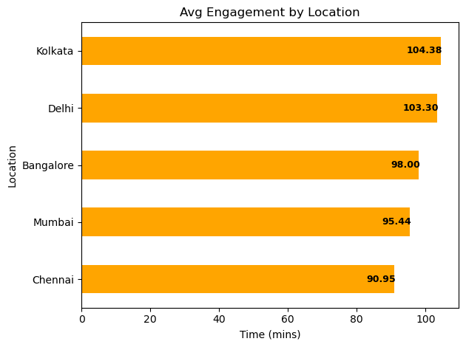
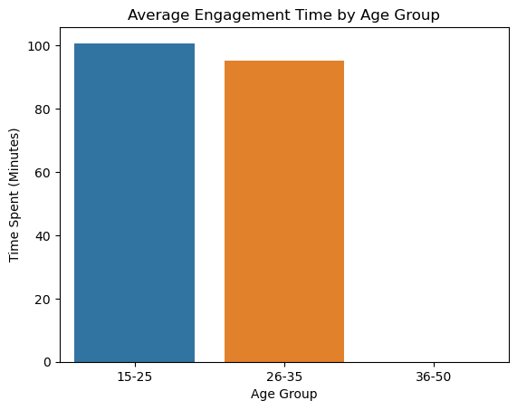
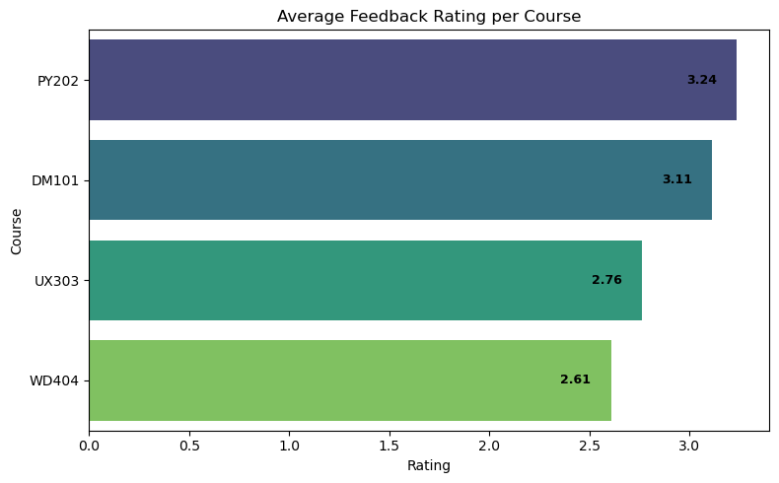
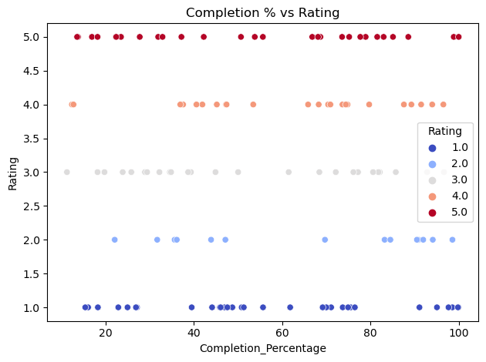
Visualizations

Slide 6
THANK YOU

